Slide 1


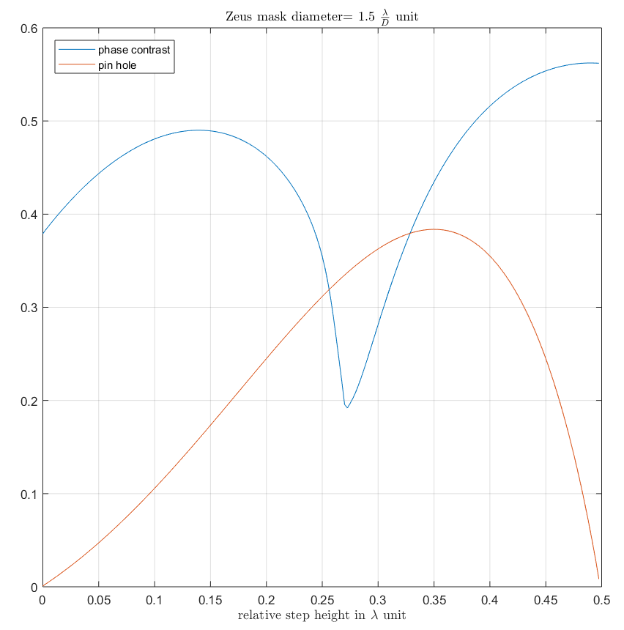
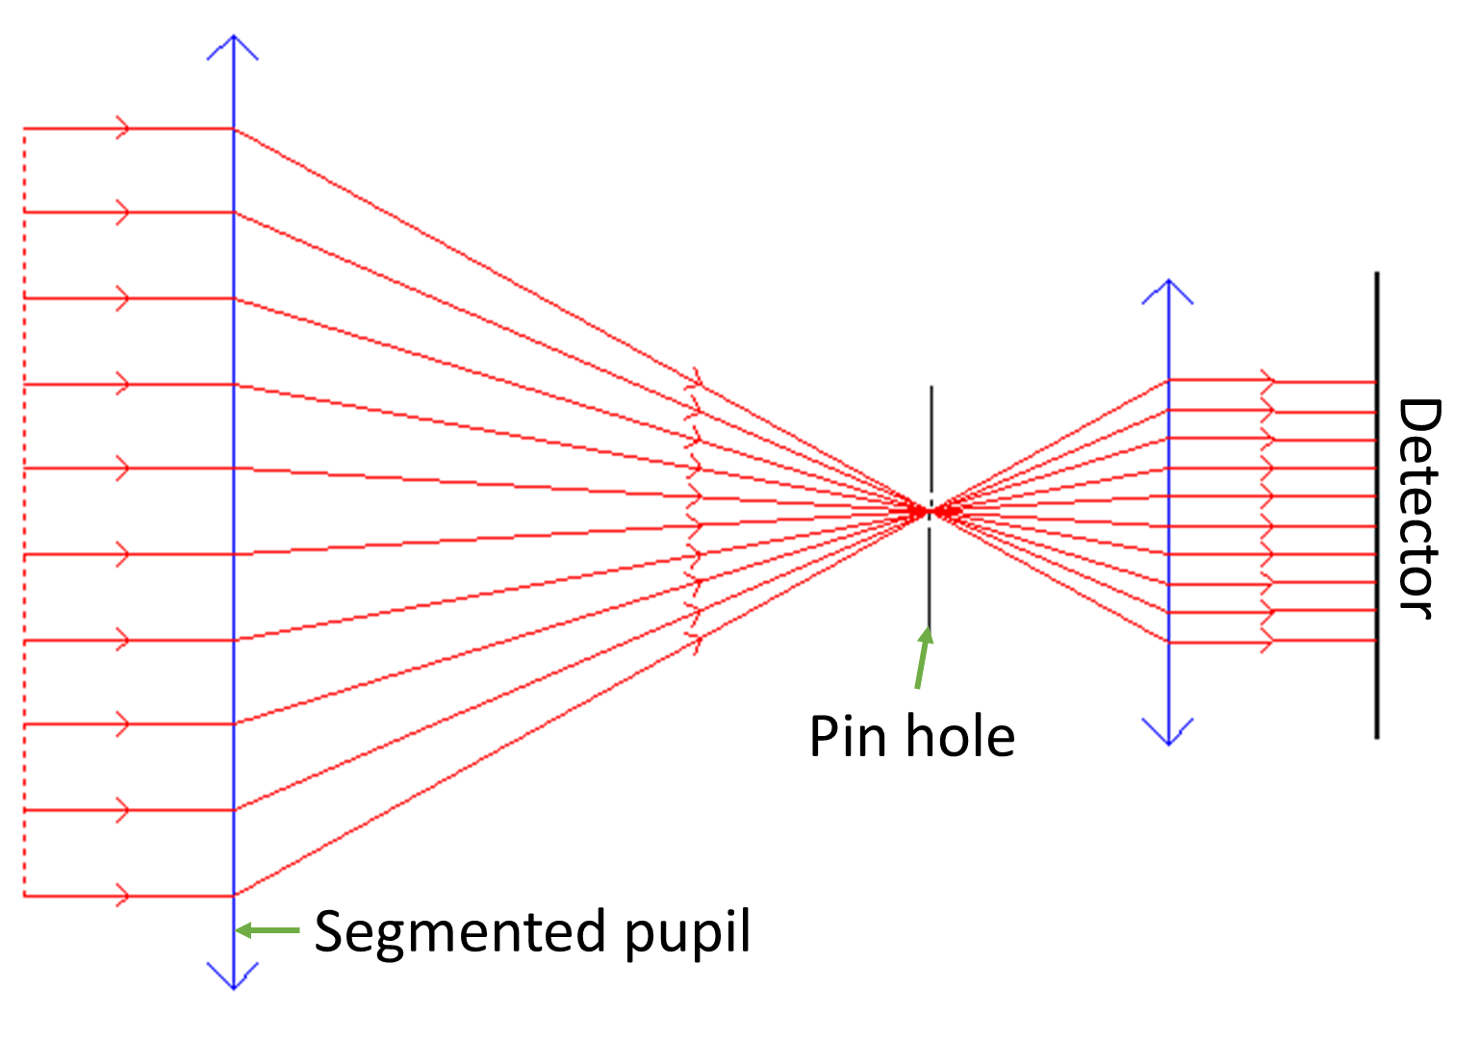
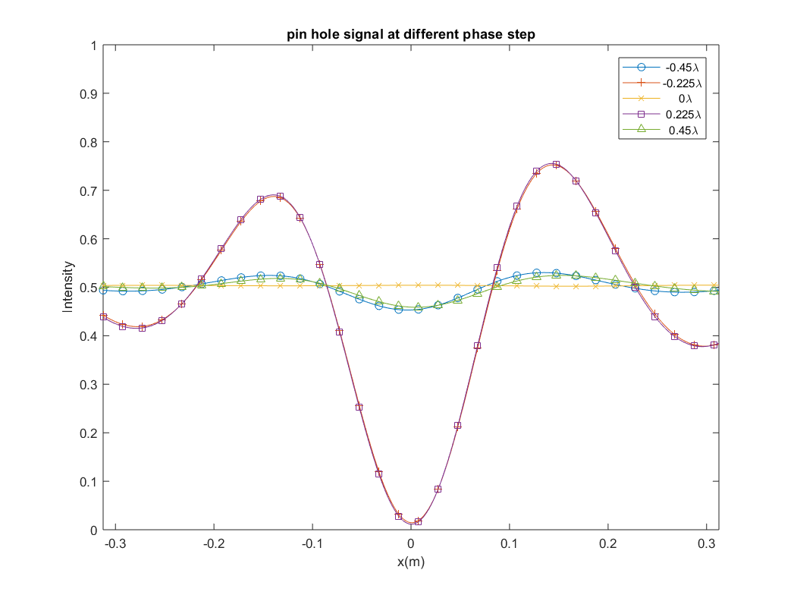
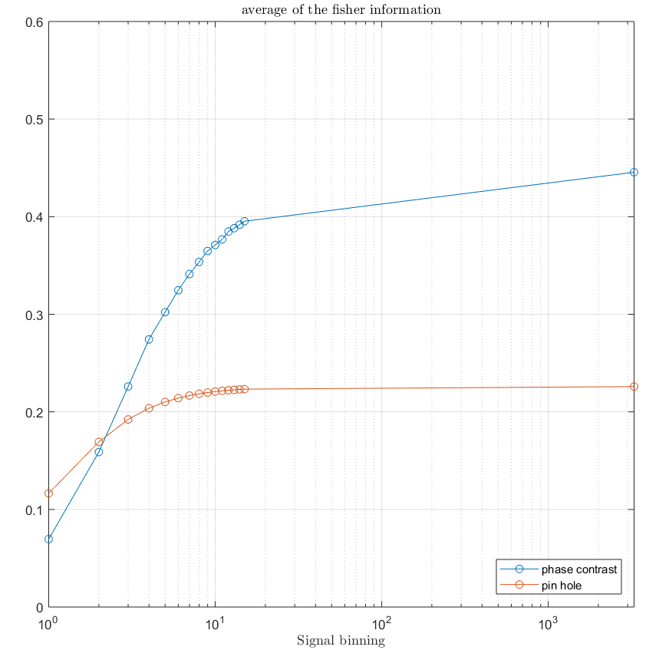
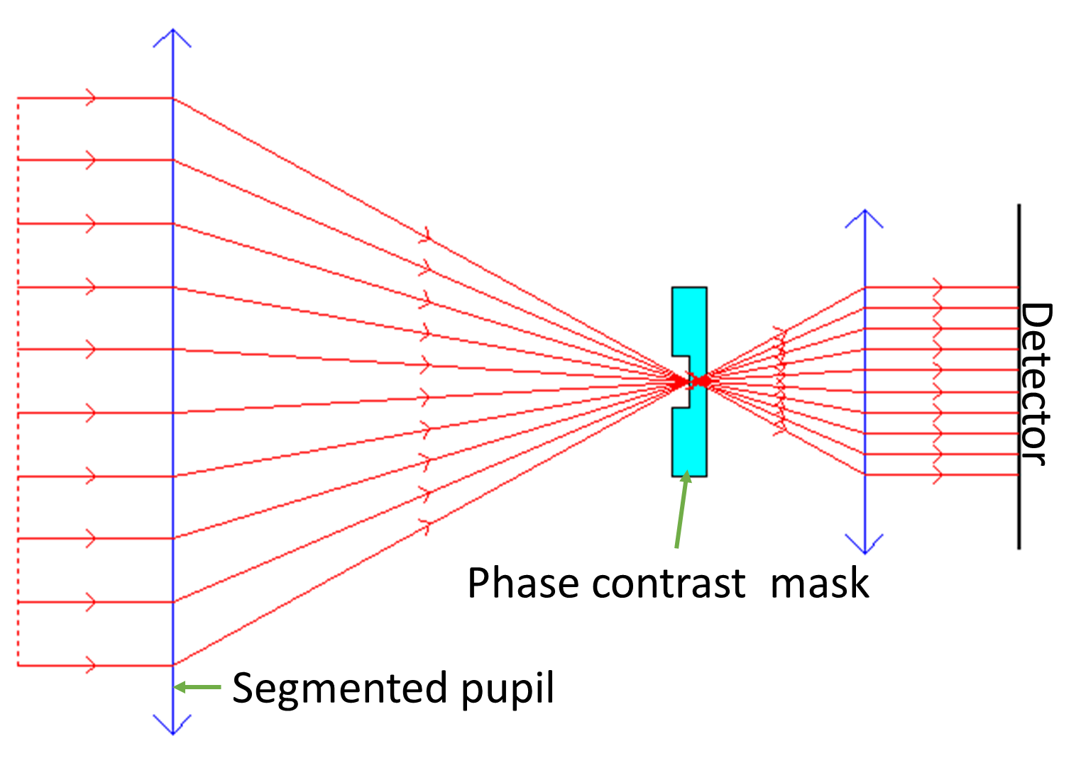
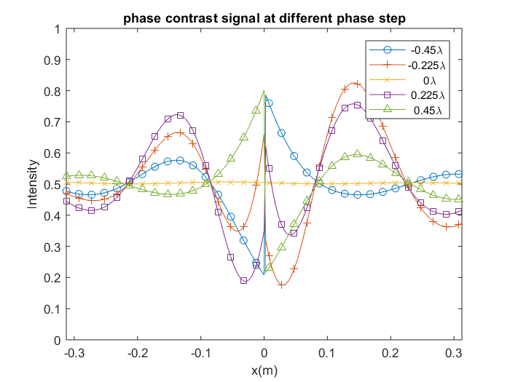
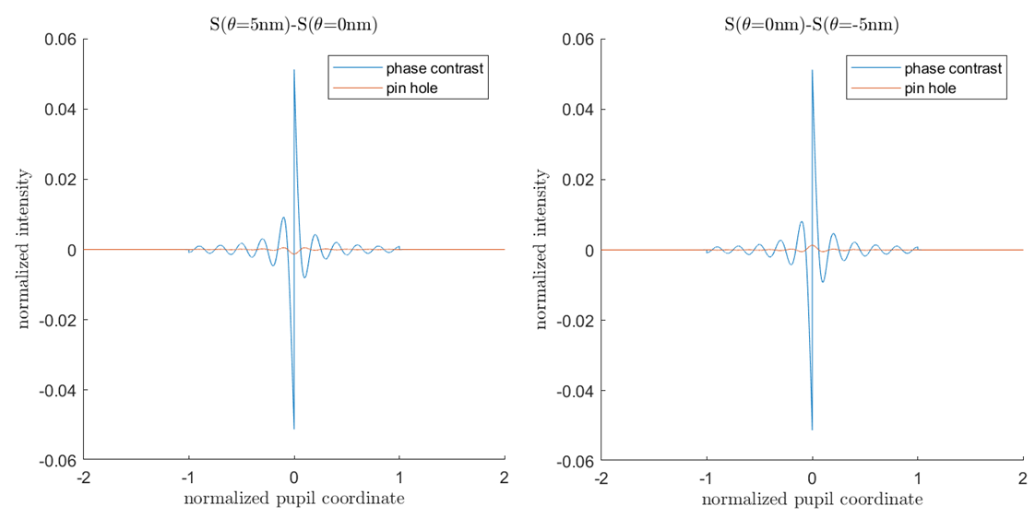
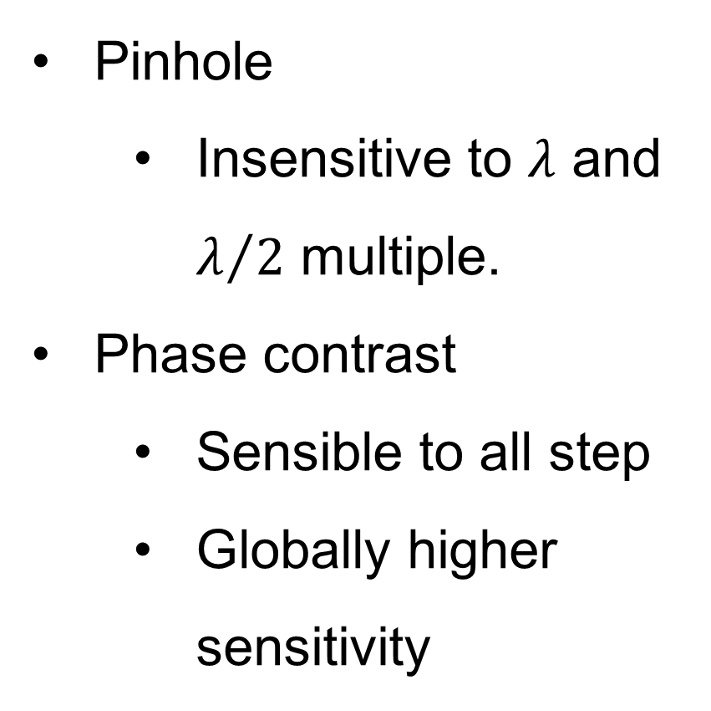
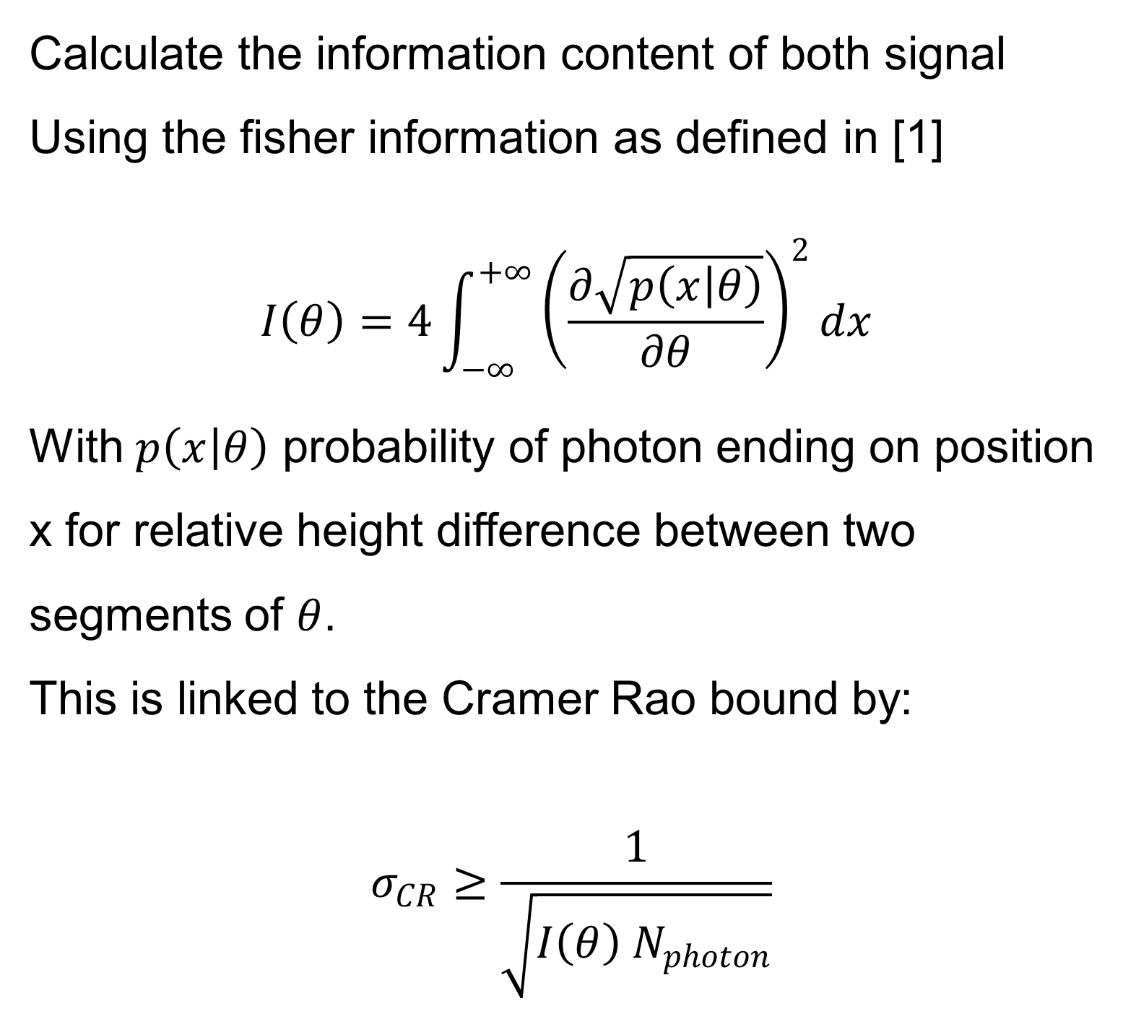
Performance of spatial filtering wavefront sensor for the phasing of segmented telescopes Lothar Noethe¹ Anne-Laure Cheffot¹² Arthur Vigan² KjetilDohlen² ¹European southern observatory / ²Laboratoire d’Astrophysique de Marseille
2nd LOGO
INTRODUCTION
RESULTS
Sensitivity to sampling
Studying phasing sensor for 30 meter class telescope:
Pinhole
Phase contrast
Ideal case without atmosphere
Ideally fitting the signal gives more information. But then the sampling become more important.
Pinhole
Insensitive to $λ$ and $λ/2$ multiple.
Phase contrast
Sensible to all step
Globally higher sensitivity
Pinhole
Sampling play a small role.
Phase contrast
Huge impact
From 3 point per signal width on average more sensitive
The insensitivity of the pinhole to small piston step become obvious when looking at the discrete derivative of the signal.
CONCLUSIONS
METHODS
With atmosphere
Aute dolor in reprehenderit.
Aute irure in reprehenderit.
Aute irure in reprehenderit.
Calculate the information content of both signal
Using the fisher information as defined in [1]
$$I\left(θ\right)=4\int_{−∞}^{+∞}{{\left(\frac{∂\sqrt{p\left(x | θ\right)}}{∂θ}\right)}^{2}dx}$$
With $p\left(x | θ\right)$ probability of photon ending on position x for relative height difference between two segments of $θ$.
This is linked to the Cramer Rao bound by:
$$σ_{CR}≥\frac{1}{\sqrt{I\left(θ\right) N_{photon}}}$$
Ut enim ad minim veniam, quis nostrud exercitation ullamco laboris nisi ut aliquip ex ea commodo consequat. Duis aute irure dolor in reprehenderit in voluptate velit esse cillum dolore eu.
Duis aute irure dolor in reprehenderit in voluptate velit esse cillum dolore eu.
REFERENCES
1. Reference, Name of reference
2. Reference, Name of reference
3. Reference, Name of reference
4. Reference, Name of reference
5. Reference, Name of reference
6. Reference, Name of reference
Footer or Copyright Information

